Slide 1


Slide 2
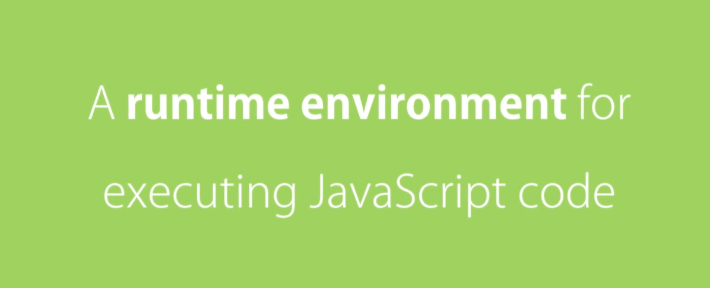

Slide 3
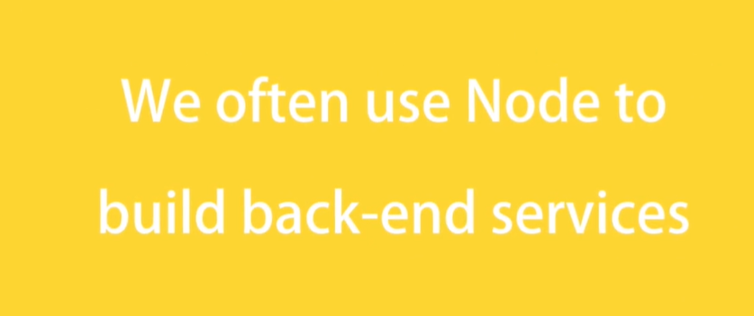

Slide 4
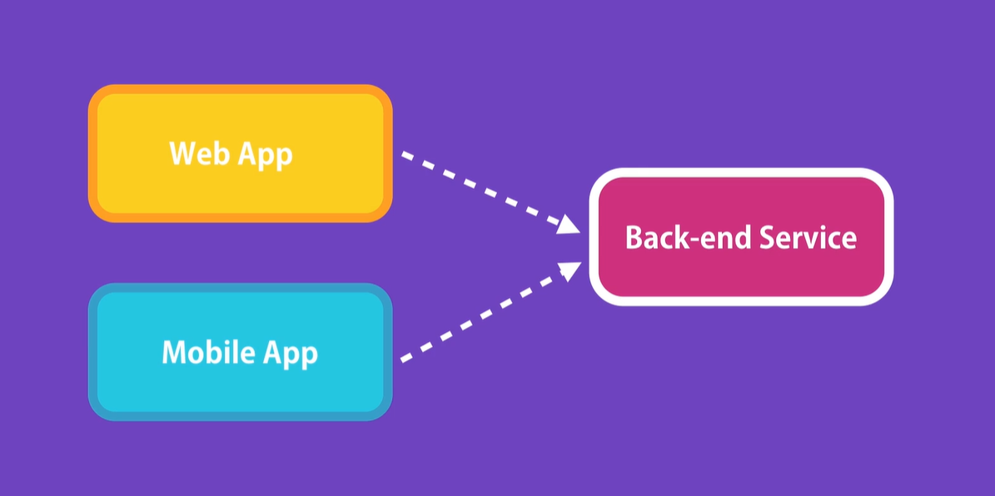

Slide 5
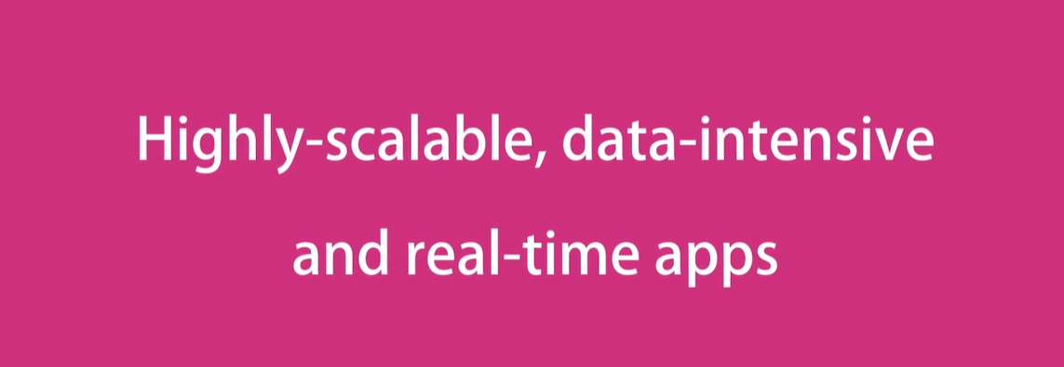

Slide 6


Slide 7
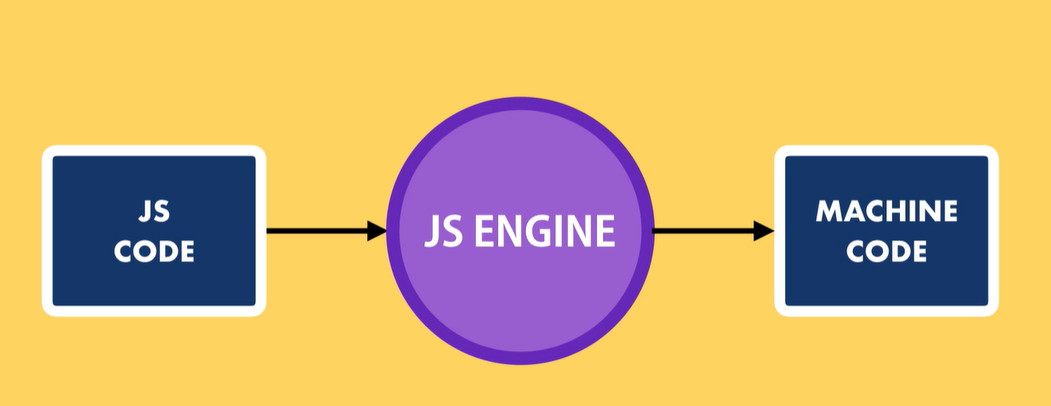
What is Nodejs Runtime
In each browser there is JS Engine that take the JS code and convert them to machine code.

Slide 8
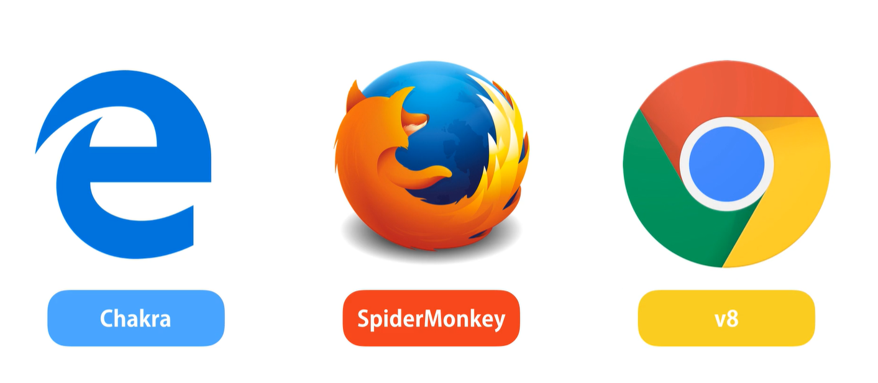
Browsers JS Engine

Slide 9
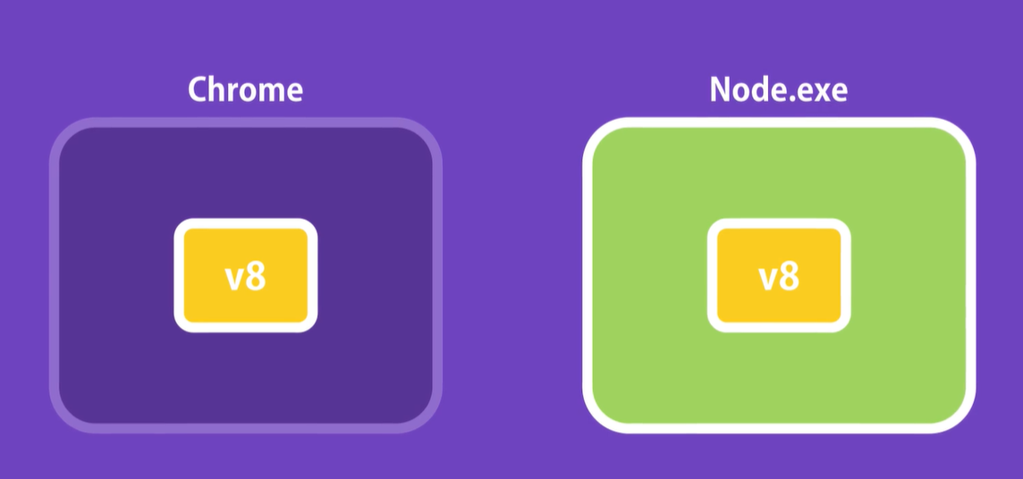
Node History
Until 2009 JS code was just running in browser In 2009 Ryan Dahl take the v8 the fastest JS engine, and embedded it inside c++
Program and called that program Node

Slide 10
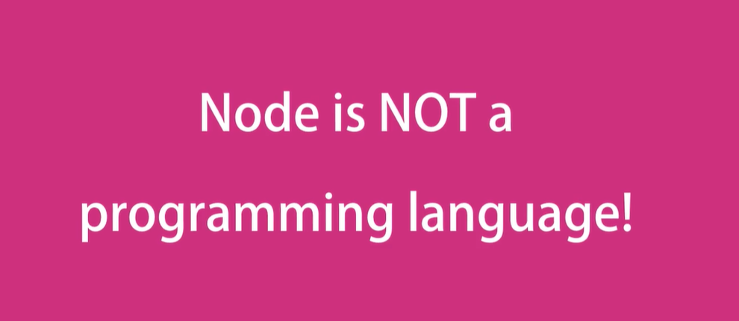

Slide 11


Slide 12
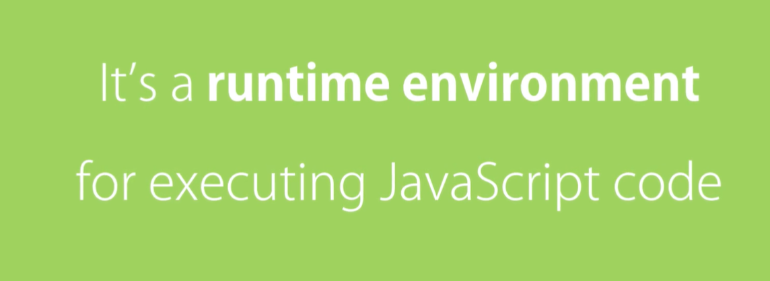

Slide 13
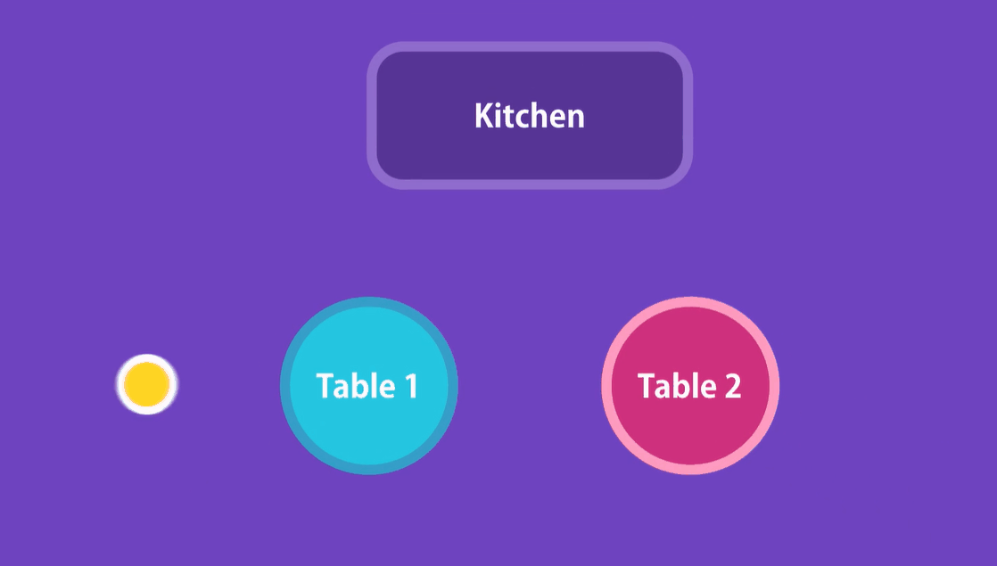
Why Node is so fast and high availability system
Its because ASYNCHRONOUS

Slide 14
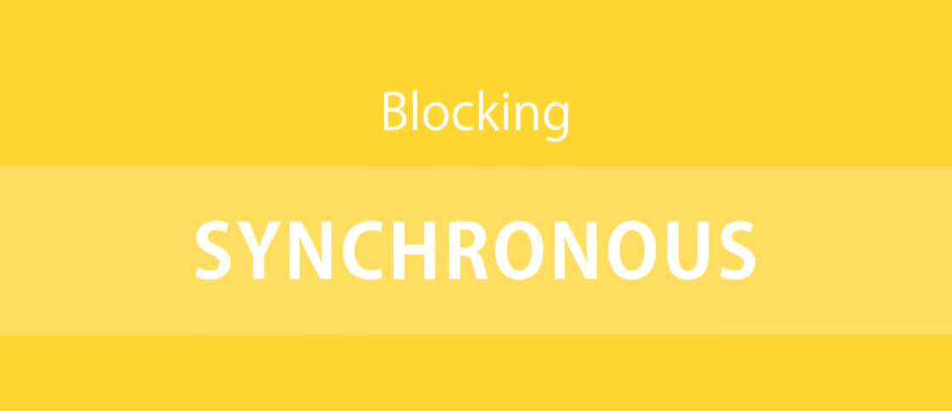

Slide 15
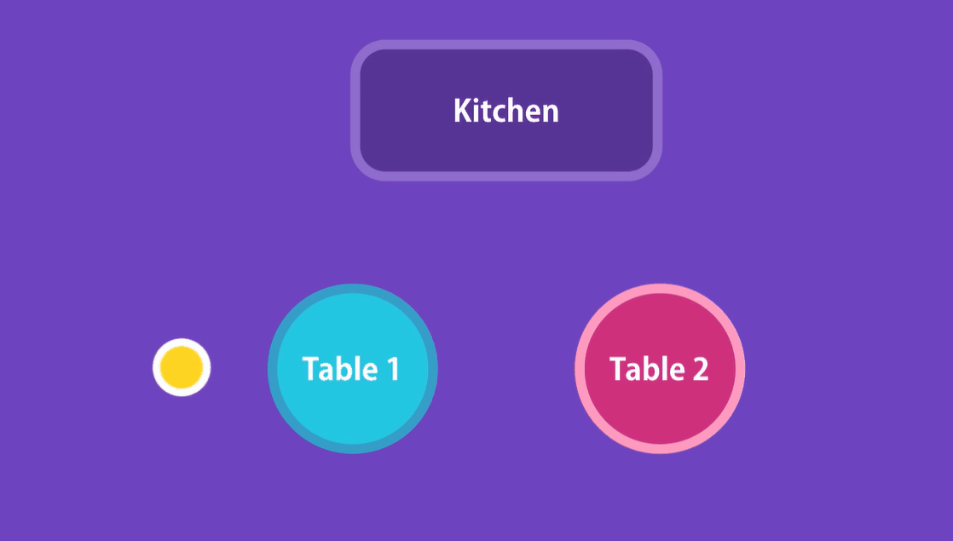
How SYNCHRONOUS blocking work

Slide 16



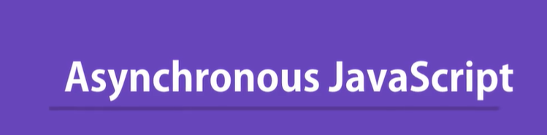
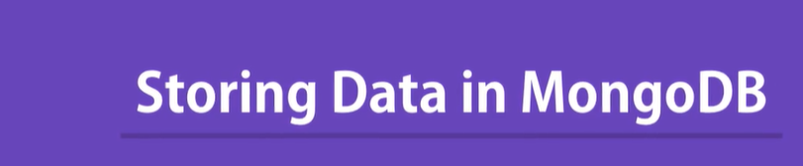


Course Structure

Slide 17
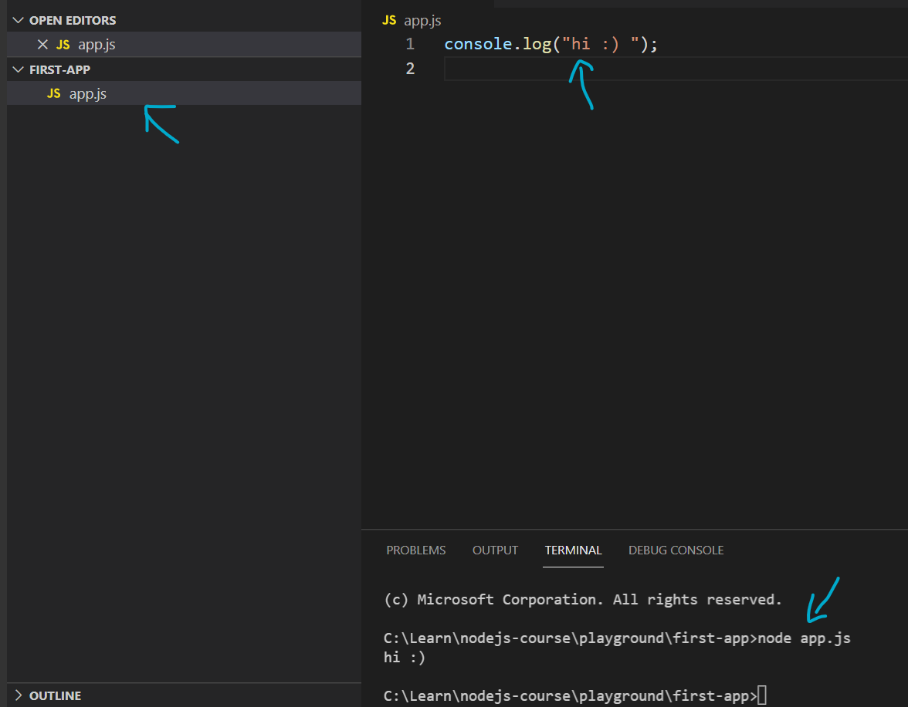
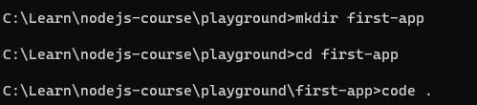
Create your first Nodejs

Slide 18
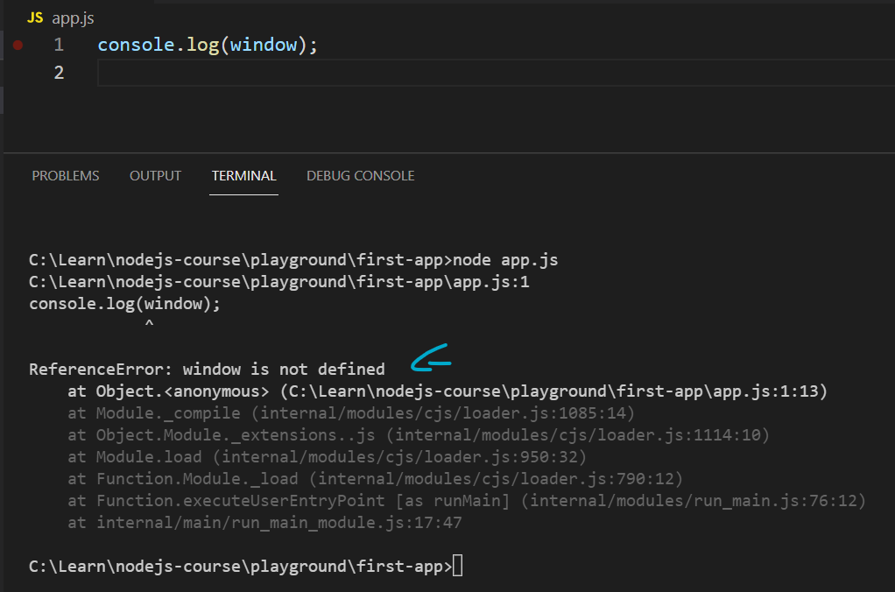
Is window object available
In node we don’t have window or document object, they are part of runtime environment that we get with browser.
In node we have other objects to work with (files networks operation system …)

Slide 19
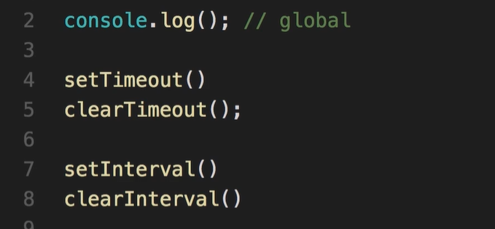
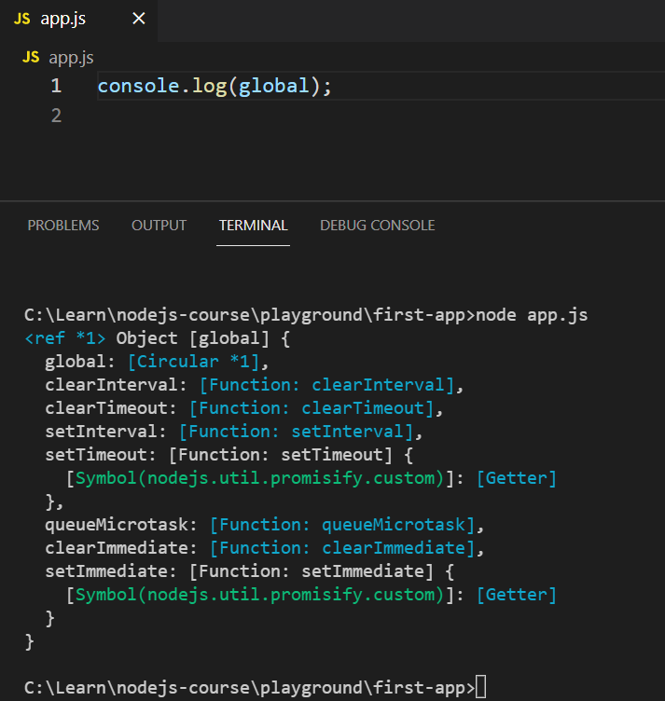
Global Object
Global objects we can access everywhere in our files for example, console that we use for logging is part of the global objects

Slide 20


Slide 21
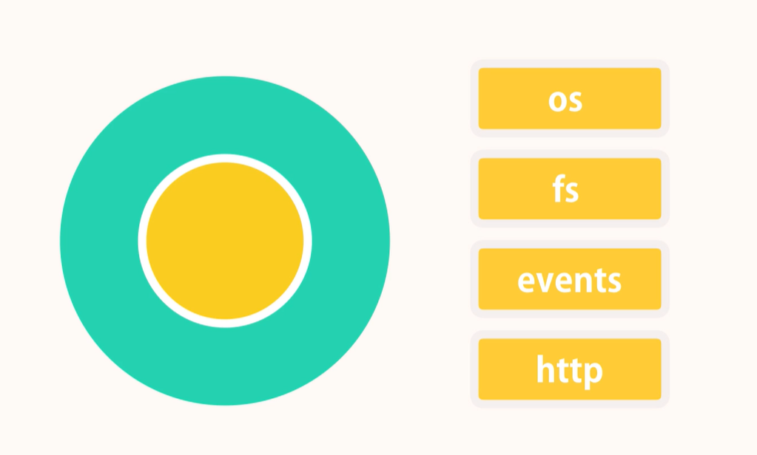
Few of the modules that built inside node

Slide 22
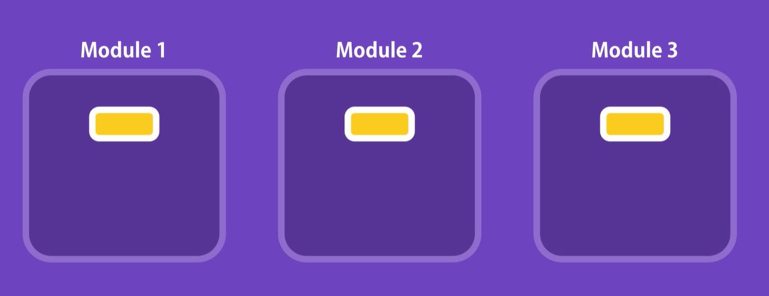
Modules
With modules we can define two variable or two functions with the same name.
Every file in NodeJS application is considered a module.
The variables and the functions that defined in that file are scoped to the file only.
* If u want to use variable or function already defined in one module outside that module, you need to explicitly
Exported it and make it public.

Slide 23
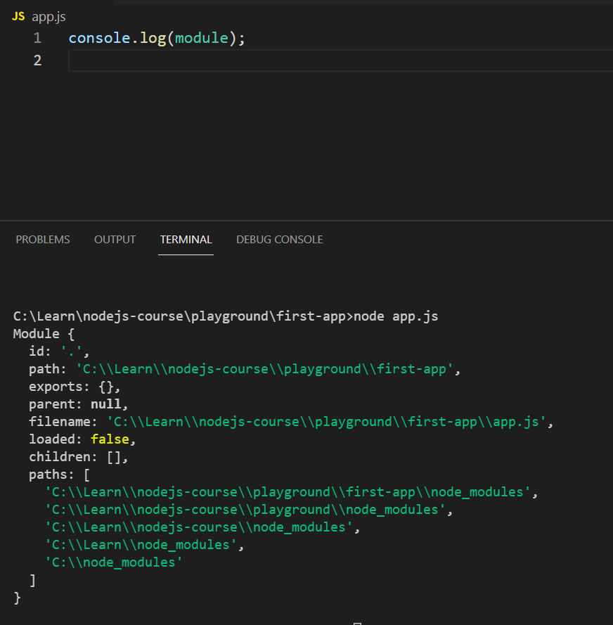
Console log the current module
Module its json object
Every module as u see have a unique id
Exports
Filename which is the complete path to that file
In node every file is Module

Slide 24
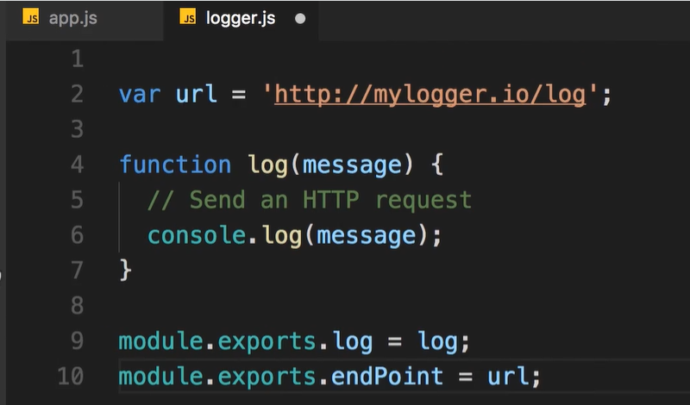
Creating a Module

Slide 25
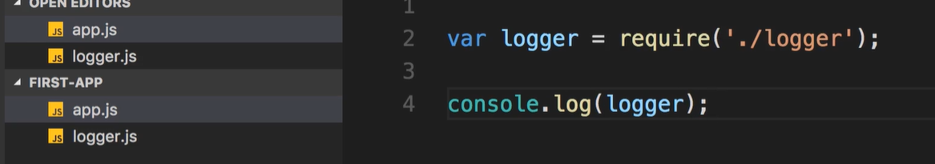
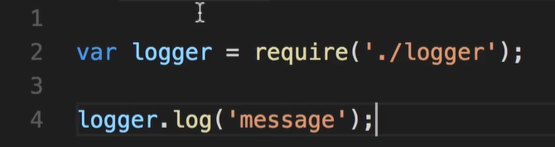
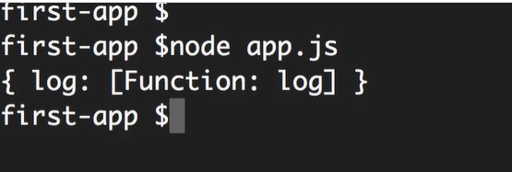
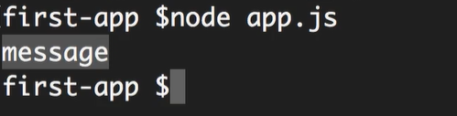
Loading a Module

Slide 26
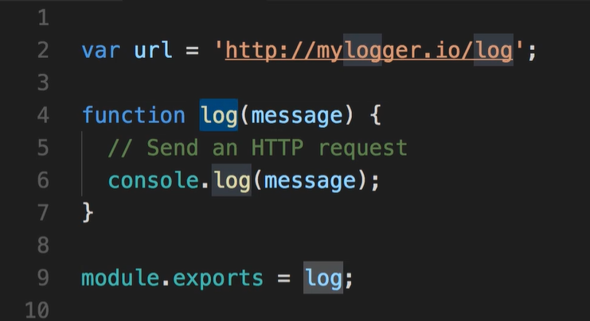
Export object
We use the export object when we want to to export multiple objects.
In our logger example in order to export a single function.

Slide 27
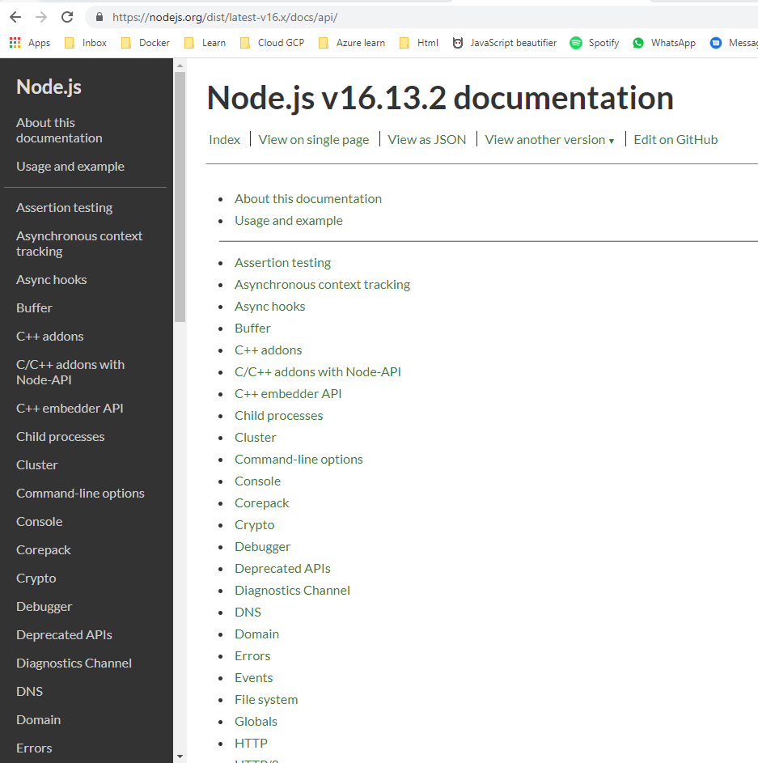
Built in Modules
Click here

Slide 28
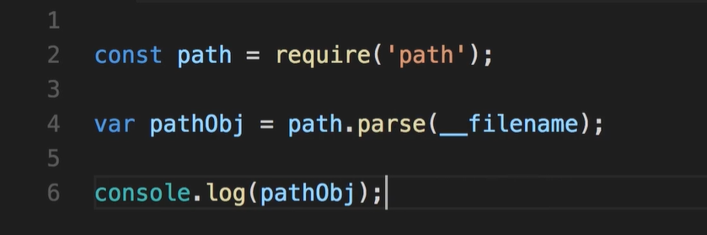
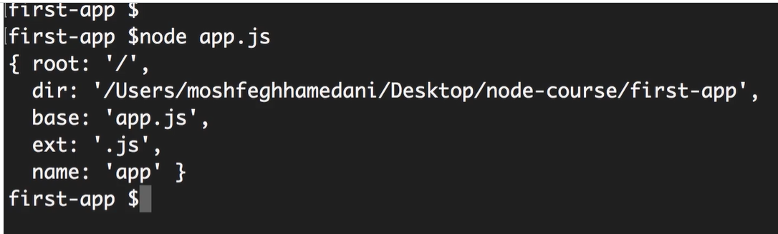
Path Module
__filename is one of the arguments that we have in each module

Slide 29
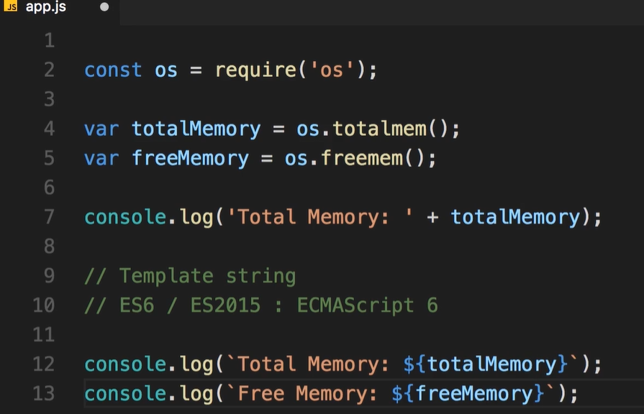
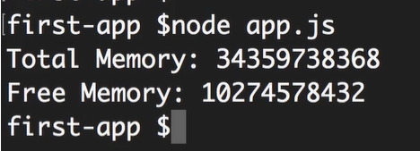
OS module
Get information about the current operation system

Slide 30
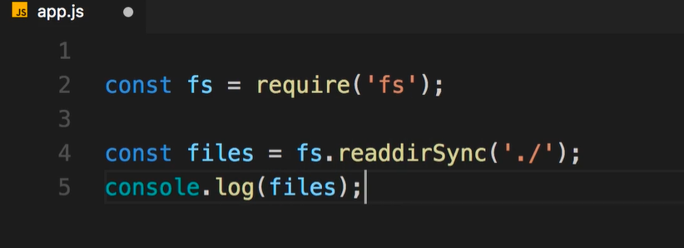
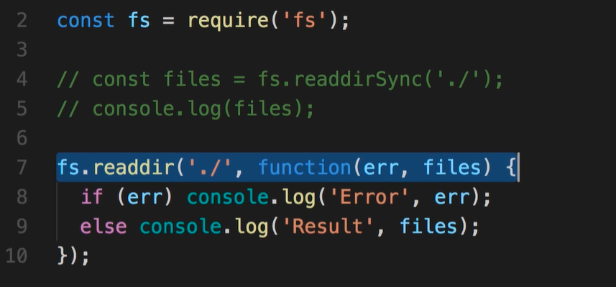
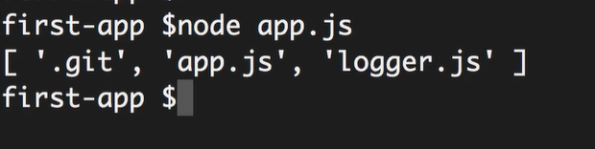
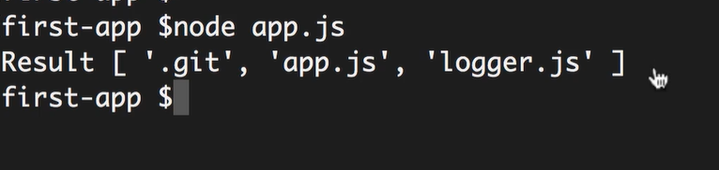
File system module
Sync version of read
Async version of reading files

Slide 31
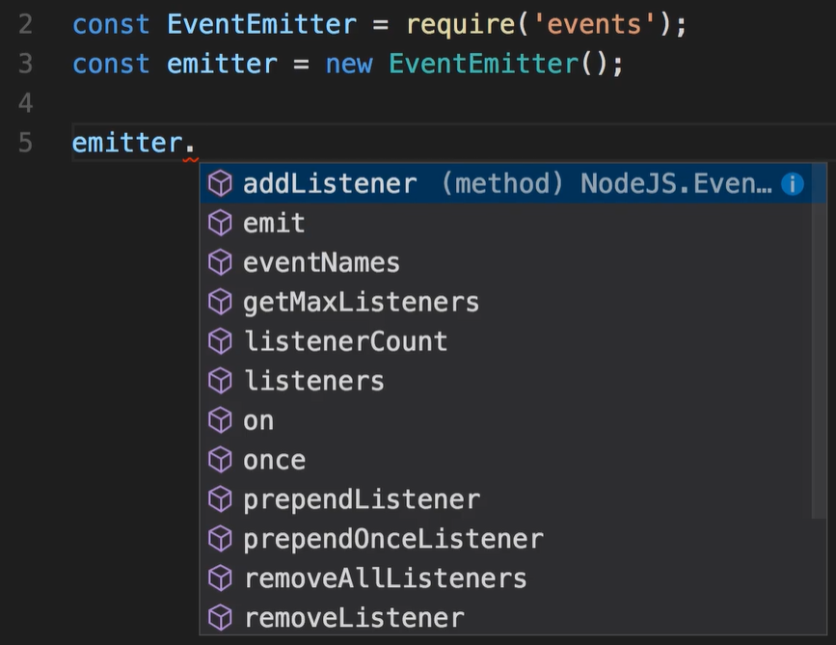
EVENTS
A lot of Node base functionality is based on this concept of events.
Events is a signal that indicates that something has happened
EventEmitter Is a class, because of that its start with capital later.
EventEmitter is a class that helps us create a publisher-subscriber pattern in NodeJS.
With an event emitter, we can simply raise a new event from a different part of an application, and a listener will listen to the raised event and have some action performed for the event.

Slide 32
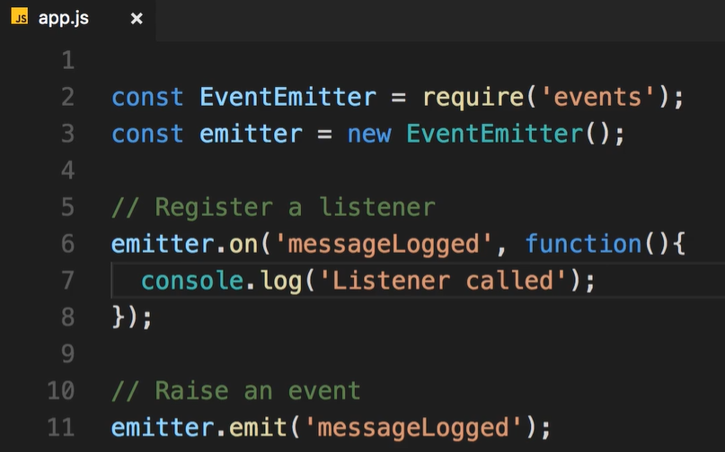
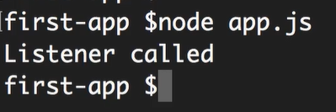
EVENTS
emit function we use for raise an event. (emit: Making a noise, produce something)
In order to see the effect of the emit, we need to register a listener somewhere. (a listener that interesting in that event)
Listener its basically a function that will be called when that event is raised

Slide 33
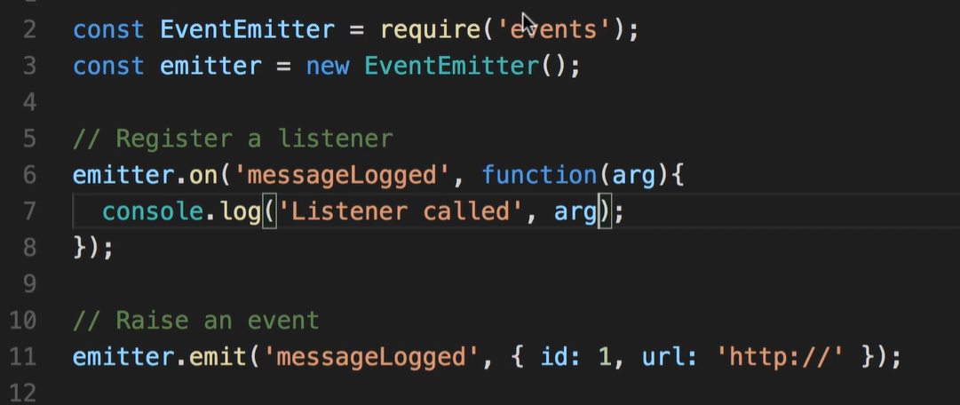
EVENTS - Arguments
Quite often, when we want to raise an event, we also want to send some data about that event.
For example, in our logger module, our logger will generate some ID for that message, and we want to return that ID.

Slide 34
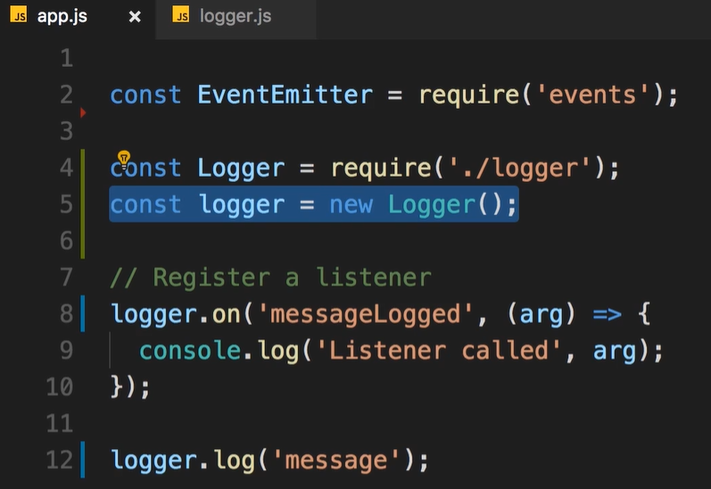
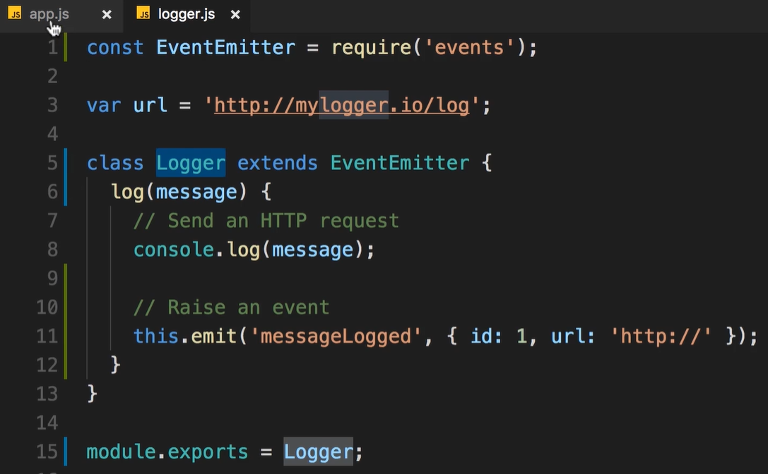
Extending EVENTS
In real world its rare that we would work with this EventEmitter Object directly. Usually you want to create a class that has all the capabilities of the EventEmitter, and then you would use that class in your code.
We usually extends the EventEmitter.

Slide 35
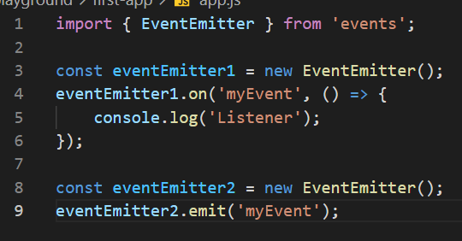
EventEmitter Instance Should Be Singleton for a Single Event Name
The listeners won’t work if registered on a separate EventEmitter instance.
This won’t print anything in the console, as there were two separate instances used in this code: one instance for registering the publisher and the other instance for listening to the event.

Slide 36
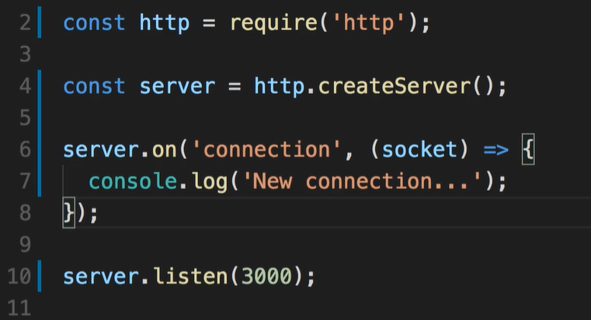
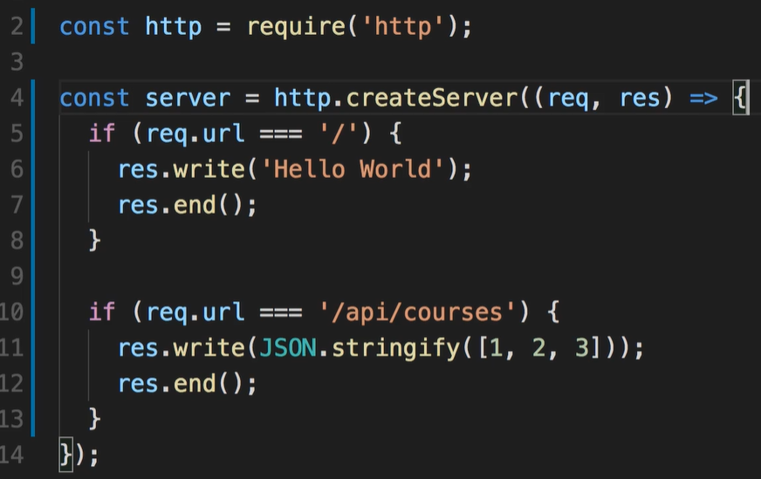
HTTP Module
http module we use for creating networking applications, for example to create a web server we can use http module.
U can see that http module using the eventEmitter extends it.
The name of the event that raised when the http completely open connection is “connection” u can fin in the documentation.

